Slide 1
Design and Implementation of an Investment Portfolio Asset Risk REST API with Spring Boot: Student Project Overview
Project goals and system architecture explained clearly
Notes:
AI-generated content may be incorrect. --- This presentation provides an overview of a student project focused on designing and implementing a REST API for investment portfolio asset risk assessment using Spring Boot. We will cover the project goals, system architecture, core features, and outcomes.

Slide 2

Agenda Overview
Project Objectives and Motivation
System Architecture and Technology Stack
Core Features and Functionality
Testing, Deployment, and Student Learning Outcomes
Notes:
--- We will begin by discussing the objectives and motivation behind the project, followed by an overview of the system architecture and technology stack. Next, we will explore the core features and functionalities of the API. Finally, we will review testing, deployment, and the key learning outcomes for students. Image source: Microsoft 365 content library

Slide 3
Project Objectives and Motivation
Notes:
This section highlights the purpose of the project, emphasizing the importance of understanding portfolio asset risk, the goals set for the REST API, and its relevance to modern investment management practices.

Slide 4

Understanding Portfolio Asset Risk
Definition of Asset Risk
Asset risk means the possibility of financial loss caused by fluctuating returns of investments in a portfolio.
Importance of Risk Understanding
Comprehending asset risk helps investors make informed decisions and manage portfolio performance efficiently.
Notes:
--- Portfolio asset risk refers to the potential for financial loss due to variability in asset returns. Understanding this risk is critical for making informed investment decisions and managing portfolio performance effectively. Image source: Microsoft 365 content library

Slide 5

Goals of the REST API Project
Reliable and Scalable API
The project focuses on building a REST API that is dependable and can handle increasing workloads efficiently.
Asset Risk Calculation
The API will calculate essential asset risk metrics to support informed investment decisions.
Secure User Interactions
The system ensures secure interactions for users accessing investment and portfolio data.
Investment Tool Integration
The API integrates seamlessly with investment tools to enhance portfolio management capabilities.
Notes:
--- The project aims to develop a reliable and scalable REST API that calculates asset risk metrics, supports secure user interactions, and integrates seamlessly with investment tools to aid portfolio management. Image source: Microsoft 365 content library

Slide 6

Relevance to Investment Management
Asset Risk Assessment
Accurate evaluation of asset risk is crucial for effective portfolio optimization and management decisions.
Regulatory Compliance
Risk assessment helps ensure adherence to financial regulations and industry standards for investment portfolios.
Risk Mitigation
Identifying and managing risks reduces potential losses and enhances portfolio stability over time.
API Support for Investors
The API provides accessible and reliable risk data that investors and analysts use for informed decisions.
Notes:
--- Accurate asset risk assessment is essential for portfolio optimization, regulatory compliance, and risk mitigation. The API supports these functions by providing accessible risk data to investors and analysts. Image source: Microsoft 365 content library

Slide 7
System Architecture and Technology Stack
Notes:
This section discusses the overall design of the system, including the use of Spring Boot, database integration, and adherence to RESTful principles to ensure modularity and extensibility.

Slide 8

Overview of Spring Boot Framework
Rapid Java Development
Spring Boot enables quick creation of production-ready Java applications with minimal setup and configuration.
Simplified Dependency Management
Spring Boot automates dependency handling to reduce complexity and streamline project setup.
RESTful Service Support
The framework offers built-in support for building scalable and maintainable RESTful web services.
Notes:
--- Spring Boot offers a powerful framework to build production-ready Java applications quickly. It simplifies dependency management, configuration, and supports rapid development of RESTful services. Image source: Microsoft 365 content library

Slide 9

Database Design and Integration
Relational Database Structure
Designed to store portfolio data, user information, and risk metrics effectively in relational tables.
API Integration
Seamless integration with API facilitates efficient data retrieval and persistence for real-time operations.
Notes:
--- A relational database was designed to store portfolio data, user information, and calculated risk metrics. Integration with the API ensures efficient data retrieval and persistence. Image source: Microsoft 365 content library

Slide 10
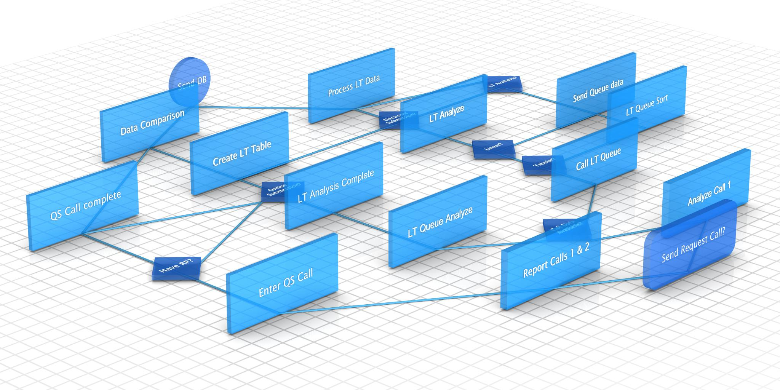
RESTful API Principles and Endpoints
RESTful Conventions
APIs follow stateless design with resource-based URLs and leverage standard HTTP methods for communication.
Risk Calculation Endpoint
This endpoint processes data to assess and return risk calculations based on input parameters.
Data Submission Endpoint
Allows clients to submit data securely to the server for processing or storage via defined API routes.
User Management Endpoint
Enables user account creation, modification, and management through the API interface.
Notes:
--- The API follows RESTful conventions such as statelessness, resource-based URLs, and standard HTTP methods. Key endpoints provide functionalities like risk calculation, data submission, and user management. Image source: Microsoft 365 content library

Slide 11
^ ensures that the pattern checks from the start of the password string.
(?=...) — Positive Lookahead
This is a "lookahead" assertion in regex.
It means: "the following pattern must be found ahead in the string, but don't consume any characters."
Example: (?=.*[A-Z]) means "there must be at least one uppercase letter somewhere ahead in the string."
.*? — Non-Greedy Match
. means "any character except newline."
* means "zero or more times."
*? is the "non-greedy" (or "lazy") version, meaning it matches as few characters as possible.
In this context, .*? is used inside the lookahead to allow any characters before the required character, but to stop as soon as the required character is found.
Together: (?=.*?[A-Z])
(?= ... ) is the lookahead.
.*? matches any number of characters (as few as possible).
[A-Z] is the required character (an uppercase letter).
So, (?=.*?[A-Z]) means: "At least one uppercase letter must appear somewhere in the string.“
Summary Table:
Part Meaning
(?=...) Lookahead: require this pattern ahead, but don't consume characters
.*? Any characters, as few as possible (non-greedy)
[A-Z] The required character (e.g., uppercase letter)

Slide 12
Core Features and Functionality
Notes:
This section details the main capabilities of the API, including risk calculation algorithms, security features, and data management processes.

Slide 13

Asset Risk Calculation Algorithms
Volatility Calculation
Volatility measures the degree of asset price variation over time, essential for assessing investment risk.
Value at Risk (VaR)
VaR estimates potential losses within a portfolio over a specified time frame at a given confidence level.
Beta Coefficients
Beta coefficients quantify an asset's sensitivity to market movements, informing portfolio diversification strategies.
Notes:
--- The API implements financial models to compute metrics such as volatility, Value at Risk (VaR), and beta coefficients, facilitating comprehensive risk analysis for portfolio assets. Image source: Microsoft 365 content library

Slide 14

User Authentication and Security Measures
Authentication Protocols
JWT tokens are used to verify user identity and secure access to sensitive data.
Access Control
Only authorized users are allowed to access portfolio data and API functionalities.
Notes:
--- Security is enforced with authentication protocols like JWT tokens, ensuring that only authorized users can access sensitive portfolio data and API functionalities. Image source: Microsoft 365 content library

Slide 15

Data Input, Output, and Validation
Data Input Accuracy
Accurate user inputs are essential to prevent errors and ensure reliable system performance.
API Response Consistency
Consistent API responses maintain system integrity and support dependable application behavior.
Error Prevention Mechanisms
Data validation prevents errors in calculations and improves overall system reliability.
Notes:
--- Robust data validation mechanisms ensure accuracy and consistency of user inputs and API responses, enhancing reliability and preventing erroneous calculations. Image source: Microsoft 365 content library

Slide 16
Testing, Deployment, and Student Learning Outcomes
Notes:
This section covers testing approaches, deployment strategies, and reflections on challenges encountered and lessons learned during the project.

Slide 17

API Testing Strategies and Tools
Automated Unit Testing
Unit tests verify individual API components to ensure correct functionality using automated tools like JUnit.
Integration Testing
Integration tests check combined API components and interactions for seamless operation in various scenarios.
Performance Testing
Performance tests evaluate API responsiveness and stability under different loads using tools like Postman.
Notes:
--- Automated unit and integration tests were developed using tools like JUnit and Postman to verify API endpoints, functionality, and performance under various scenarios. Image source: Microsoft 365 content library

Slide 18

Deployment Process and Hosting Options
Cloud Platform Deployment
The API is hosted on cloud platforms that provide scalable infrastructure for Java application deployment.
Containerization Technology
Containerization enables consistent environments and easy application packaging for deployment and scaling.
Continuous Integration Pipelines
Continuous integration pipelines automate testing and deployment, ensuring smooth delivery and updates.
Notes:
--- The API was deployed on cloud platforms supporting Java applications, leveraging containerization and continuous integration pipelines for smooth delivery and scalability. Image source: Microsoft 365 content library

Slide 19

Key Challenges and Lessons Learned
Challenges in Spring Boot
Students struggled with mastering complex Spring Boot configurations and secure authentication setups.
Skill Enhancement
The project improved students' backend development and API design skills significantly.
Collaborative Problem Solving
Students learned effective teamwork and collaborative problem-solving throughout the project.
Notes:
--- Students faced challenges such as mastering Spring Boot configurations and implementing secure authentication. The project enhanced their skills in backend development, API design, and collaborative problem-solving. Image source: Microsoft 365 content library

Slide 20
Why mock tests?
Mock tests are not strictly necessary, but they are highly recommended for unit testing services like UserService.
You could write simple tests without mocks, but:
You would need a real database or in-memory database, and real dependencies.
Your tests would be slower, harder to set up, and could fail for reasons unrelated to your service logic (like database issues).
Mocks let you:
Test only your service logic, not the database or external systems.
Make tests fast, reliable, and easy to control.
Simulate different scenarios (user exists, user does not exist, etc.) easily.
In summary:
For true unit tests of service classes, mocking is best practice.
For integration tests (testing everything together), you can use real dependencies, but those are a different kind of test.
For your UserService, using mocks is the standard and most effective approach.

Slide 21
Conclusion
Secure REST API Design
The project implemented a secure REST API ensuring safe data exchange and efficient processing.
Investment Portfolio Risk Assessment
The API evaluates asset risks to help manage investment portfolios effectively and reliably.
Hands-on Software Development
The project offered practical experience in developing technology solutions within investment domains.
Notes:
The project successfully demonstrated the design and implementation of a secure, efficient REST API for investment portfolio asset risk assessment. It provided valuable hands-on experience in software development and investment technology.

